Slide 1




Course name: Electrical & Electronics System (EE1002)
B.TECH FIRST YEAR
ACADemic YEAR: 2023-2024
Course code : EE 1002
lecture series no : 09 (one)
Credits : 04
Mode of delivery : oFF line (Power point presentation)
Faculty : Mr. ritesh singh
Email-id : ritesh.singh@jaipur.manipal.edu
PROPOSED DATE OF DELIVERY: 16 Aug 2023

Slide 2
Session outcome
“Analyse DC circuit using superposition theorem”

Slide 3
Assessment criteria’S
Assignment
quiz
mid term examination
END TERM EXAMINATION

Slide 4

PROGRAM OUTCOMES MAPPING WITH CO1
[PO1]
Engineering Knowledge: Apply the knowledge of mathematics, science, engineering fundamentals, and an engineering specialization to the solution of complex engineering problems.

Slide 5
DC Network Theorems:
Superposition Theorem
Lecture No. 10

Slide 6
Contents
Topic:
1. Superposition Theorem

Slide 7
DC Network Theorems
An electrical Circuit is an interconnection of electrical components (e.g., batteries, resistors, inductors, capacitors, switches, transistors and voltage sources & current sources).
An electrical circuit is a network consisting of a closed loop, giving a return path for the current.
Using different theorems, response of the different sources (voltage & current) on the particular load of the circuit can be calculated.
These theorems are as given below,
Superposition Theorem
Thevenin Theorem
Maximum Power Transfer Theorem

Slide 8
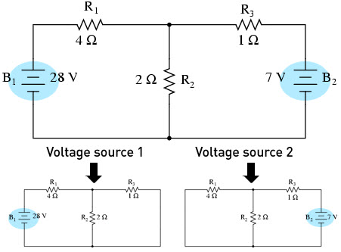
Superposition Theorem
Statement:- In a linear network with several independent sources, the response in a particular branch when all the sources are acting simultaneously is equal to the linear sum of individual responses calculated by taking one independent source at a time. Superposition theorem is used only in linear networks.
Problem-1-: Find the voltage drop across the 2 ohm (R2) resistor using superposition theorem.
Fig.1 Explanation of Superposition Theorem

Slide 9
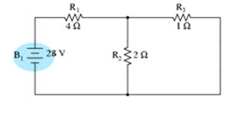
In the above figure, the circuit with two voltage sources is divided into two individual circuits according to this theorem’s statement.
In first case used only one voltage source and other voltage source is replace with their internal resistance which is zero in case of voltage source and infinity in case of current source. So voltage source is changed to short circuit and current source is changed by open circuit. And find the current in the specific branch.
In First Case-: Applied only first voltage source and short circuit the second voltage source.
R2 and R3 are connected in parallel and equivalent resistant is connected in series with the R1.
R_{1eq} = R₂||R₃ + R₁
R_{1eq} = 2||1 + 4
R_{1eq} = 2/3 + 4
R_{1eq} = 14/3 ohms
Current with draw from the source-1 is calculated by I₁ = V₁ / R_{1eq} = 28*3/14 = 6 Amp

Slide 10
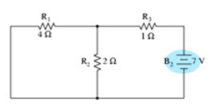
Now calculate the current in the R₂ branch due the first voltage source only is I₁₁ = I₁* R₃ /(R₃ + R₂)
= 6*1/(1+2) =2 Amp
In Second Case-: Applied only second voltage source and short circuit the first voltage source.
R₁ and R₂ are connected in parallel and equivalent resistant is connected in series with the R₃.
R_{2eq} = R₁||R₂ + R₃
R_{2eq} = 4||2 +4
R_{2eq} = 8/6 + 4
R_{2eq} = 16/3 ohms
Current with draw from the source-2 is calculated by I₂ = V₂ / R_{2eq} = 7*3/16 = 1.31 Amp
Now calculate the current in the R₂ branch due the second voltage source only is I₂₁ = I₂* R₁ /(R₂ + R₁)
= 1.31*4/(4+2) = 0.873 Amp
Total current in the R₂ branch is calculated by sum of the current flow due to the individual voltage sources = 2 + 0.873 = 2.873 Amp

Slide 11
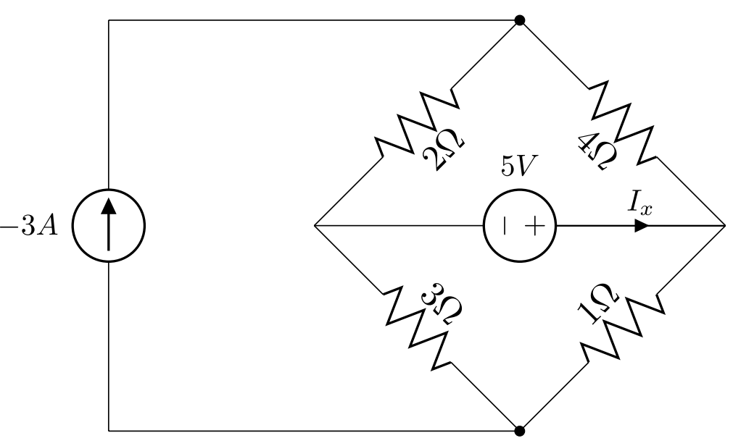
Problem-2-: Find the value of I_{x} using superposition theorem.
Fig.1
There are two sources so it is required to apply the source one by one as per superposition theorem state to calculate the value of I_{x}. First apply 5 V voltage source and replace current source with open terminal.

Slide 12
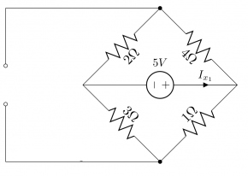
Step-1
Let's start with the voltage source and change the current source with its internal resistance (open circuit)
as shown in Fig 2.
Fig.2
In the Fig. it can be seen that the 4Ω and 2Ω resistors are connected in series so total resistor become 6Ω.
Similarly 3Ω and 1Ω resistors are also connected in series so total resistor become 4Ω. In addition 6Ω and 4Ω resistors are connected in the parallel to the source voltage as shown in Fig 3.

Slide 13
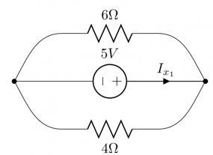
Fig.3
Now 4Ω and 6Ω are connected in parallel and equivalent resistance become :
R_{4Ω||6Ω} =(4×6)/(4+6)=2.4Ω
Now calculate the value of I_{x1}
I_{x1} =5V/2.4Ω=2.083A

Slide 14
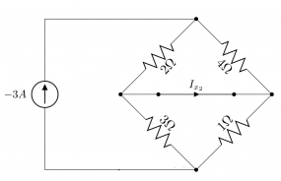
To continue solving the circuit with the Superposition theorem, the voltage source is changed to the short circuit and only current source is applied on the circuit and find the contribution of the current source on I_{x}. I_{x2} is taken as the contribution of the current source.
Fig.4
We can easily apply KCL and find I_{x2} . So, 4Ω and 2Ω are connected in parallel and also 3Ω and 1Ω are connected in parallel:
R_{4Ω||2Ω}=(4×2)/(4+2)=4/3Ω R_{3Ω||1Ω} =3/4Ω

Slide 15
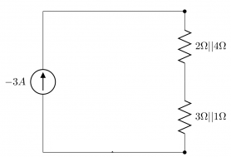
V_{2Ω||4Ω}=4/3*(−3) = −4V
V_{3Ω||1Ω} =3/4*(−3) = −2.25V
Please note that the voltage drop on 4Ω||2Ω is the same as 4Ω and 2Ω voltage drops, because the circuits are equivalent and all are connected to the same nodes. The same statement is correct for 3Ω||1Ω voltage drop and 3Ω and 1Ω voltage drops. So
V_{4Ω}=V_{2Ω}=V_{2Ω||4Ω}= −4V
V_{3Ω||1Ω}=V_{3Ω||1Ω}=V _{3Ω||1Ω} = −2.25V

Slide 16
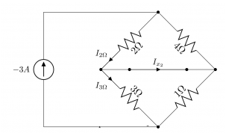
To find I_{x2} all we need is to write KCL at one of the nodes:
I_{x2} = I_{2Ω} − I_{3Ω}
I_{2Ω} =V_{2Ω} /2Ω=−4/2=−2A
I_{3Ω} =V_{3Ω} /3Ω=−2.25/3=−0.75A
I_{x2} =−1.25A
Therefore, Using Superposition,
I_{x} = I_{x1} + I_{2x}
=2.083−1.25=0.8333A

Slide 17
THANK YOU

